Slide 1

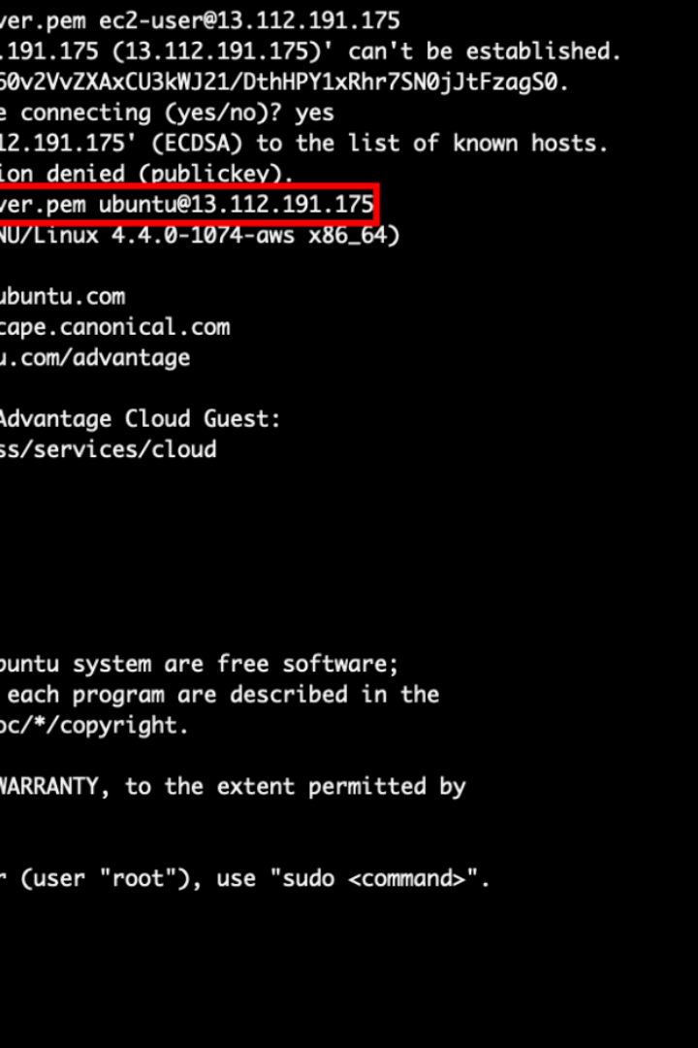


File Handling Utilities
Discover the essential file handling utilities for efficient management of files and directories in Linux systems.
by Hema v

Slide 2
The touch Command
Create new files or modify timestamps with the touch command. Use options like -a to change access time and -m to modify the modification time of a file.
touch myfile.txt: Create a new file
touch -a myfile.txt: Change the access time
touch -m myfile.txt: Change the modification time

Slide 3

The cat Command
Display file contents or concatenate multiple files using the cat command. Use options like -n for line numbers and -v for non-printing characters.
cat myfile.txt: Display file contents
cat myfile1.txt myfile2.txt: Concatenate multiple files
cat -n myfile.txt: Display contents with line numbers

Slide 4

The cp Command
Copy files and directories efficiently with the cp command. Use options like -a to copy all attributes and -r for recursive copy.
cp myfile.txt myfile_copy.txt: Copy a file
cp -r mydir mynewdir: Copy a directory

Slide 5

The mv Command
Move files and directories seamlessly with the mv command. Use options like -i to prompt before overwriting an existing file.
mv myfile.txt myfile_new.txt: Move a file
mv mydir mynewdir: Move a directory
mv mydir/* .: Move files to the current directory

Slide 6

The rm Command
Delete files and directories effortlessly with the rm command. Use options like -r for recursive deletion and -i to prompt before deleting.
rm myfile.txt: Delete a file
rm -r mydir: Delete a directory
rm -r mydir/*: Delete files in a directory
rm *.txt: Delete files with a specific extension

Slide 7

The mkdir Command
Create directories effortlessly with the mkdir command. Use the -p option to create directories recursively, including parent directories.
mkdir mydir: Create a directory
mkdir -p mydir: Create a directory with parent directories
mkdir mydir1 mydir2 mydir3: Create multiple directories

Slide 8


The find Command
Search for files and directories efficiently with the find command. Use options like -name to match specific names and -type to match specific types.
find . -name myfile.txt: Find files with a specific name
find . -type d: Find directories
find . -size +100M: Find files larger than a certain size

Slide 9

The grep Command
Search for text within files using the grep command. Use options like -n for line numbers and -i to ignore case distinctions.
grep hello myfile.txt: Search for a word in a file
grep ^hello myfile.txt: Search for lines starting with a word

Slide 10

The sort Command
Sort lines in a file using the sort command. Use options like -n for numerical sorting and -u to remove duplicate lines.
sort myfile.txt: Sort lines in ascending order
sort -r myfile.txt: Sort lines in descending order
sort -n myfile.txt: Sort lines numerically

Slide 11

The uniq Command
Remove duplicate lines from a file using the uniq command. Use options like -c to count occurrences and -d to print duplicate lines.
uniq myfile.txt: Remove adjacent duplicate lines
uniq -c myfile.txt: Count the occurrences of each line

